Slide 1
Convolutional Neural Network
Pang Liang

Slide 2
Content
Derivation
Definition
Application
Implementation
Extension

Slide 3
Deviation – Term Expansion
Activation
Error
Feed Forward
Back Propagation
Neural Network
Layer/Connection
Active Function
Full-Conn Layer
Conv Layer
Pooling Layer
Sigmoid
Tanh
Rectify

Slide 4
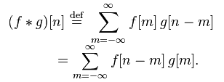

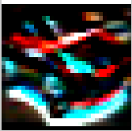
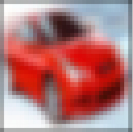
Deviation – Term Expansion
Signal
Math
Convolution
Image
Edge
Blur
-1
-2
-1
4
7
4
0
0
0
7
10
7
1
2
1
4
7
4

Slide 5
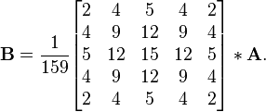


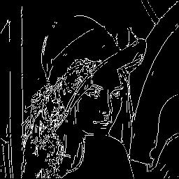
Canny, John. "A computational approach to edge detection." Pattern Analysis and Machine Intelligence, IEEE Transactions on 6 (1986): 679-698.
Deviation – Canny Edge Detection
Canny Edge Detection Steps:
RGB image convert to Gray image.
Noise reduction.
Finding the intensity gradient of the image.
Non-maximum suppression.
Tracing edges through the image and hysteresis thresholding.
Gaussian filter
Edge detection operator

Slide 6
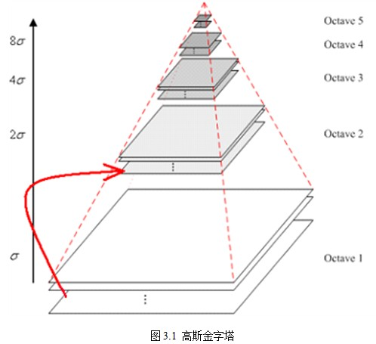
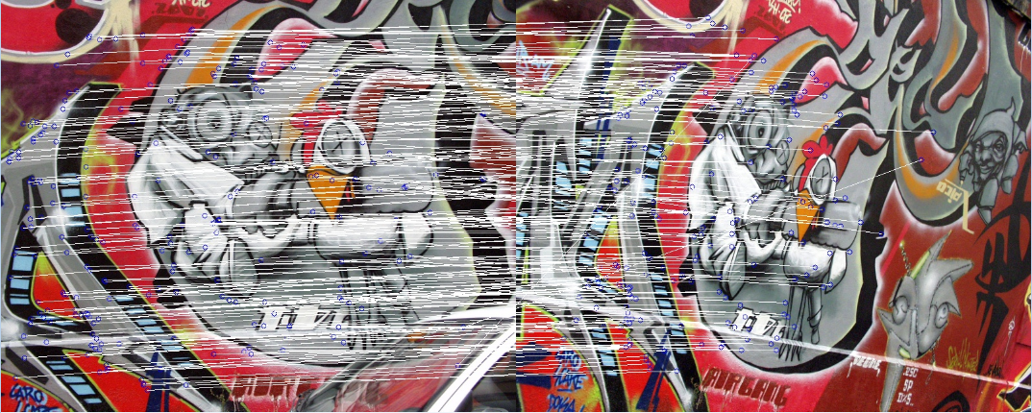
Lowe, David G. "Object recognition from local scale-invariant features."Computer vision, 1999. The proceedings of the seventh IEEE international conference on. Vol. 2. Ieee, 1999.
Deviation – SIFT Features
Scale-invariant feature transform (or SIFT) is an algorithm in computer vision to detect and describe local features in images.
Scale-space extrema detection.
Keypoint localization.
Orientation assignment.
Keypoint descriptor.
Gaussian blur：

Slide 7
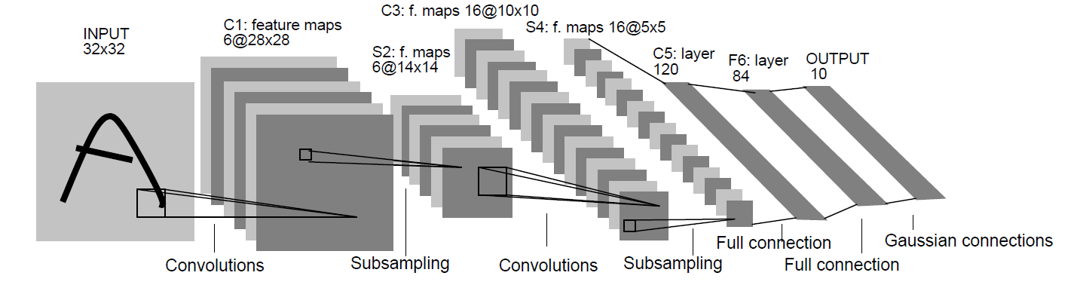
Deviation – Important properties
LeCun, Yann, et al. "Gradient-based learning applied to document recognition."Proceedings of the IEEE 86.11 (1998): 2278-2324.
Convolutional Networks combine three architectural ideas to ensure some degree of shift, scale, and distortion invariance: local receptive fields, shared weights (or weight replication), and spatial or temporal sub-sampling.
Shift invariance
Scale invariance
Distortion invariance
Local receptive fields
Shared weights
Sub-sampling
LeNet-5

Slide 8
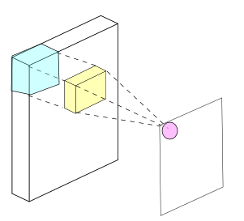
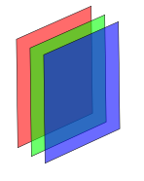

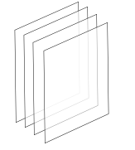
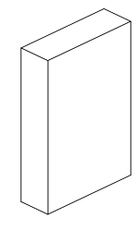

Definition – Convolutional Layer
Image
RGB – 3 Channels
Feature maps
Filter count = Output channels
n Channels
x_{i,j} stands for input patch centered at location (i, j)
k is the index of output feature map

Slide 9
Definition – Pooling Layer
Max Pooling Layer
Forward
Backprop
1
2
1
0
0
0
5
6
1
9
0
0
0
1
1
9
1
0
1
0
Average Pooling Layer
Forward
Backprop
1
2
1
1
1
1
5
6
1
3
1
1
1
9
1
9
1
1
1
1

Slide 10
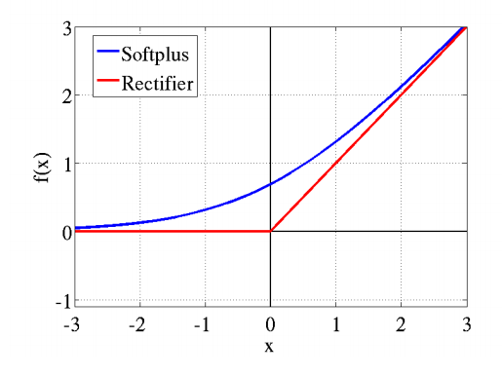
Definition – Active Function
Nair, Vinod, and Geoffrey E. Hinton. "Rectified linear units improve restricted boltzmann machines." Proceedings of the 27th International Conference on Machine Learning (ICML-10). 2010.
Glorot, Xavier, Antoine Bordes, and Yoshua Bengio. "Deep sparse rectifier networks." Proceedings of the 14th International Conference on Artificial Intelligence and Statistics. JMLR W&CP Volume. Vol. 15. 2011.
ReLU : rectified linear unit
The rectifier activation function allows a network to easily obtain sparse representations.

Slide 11
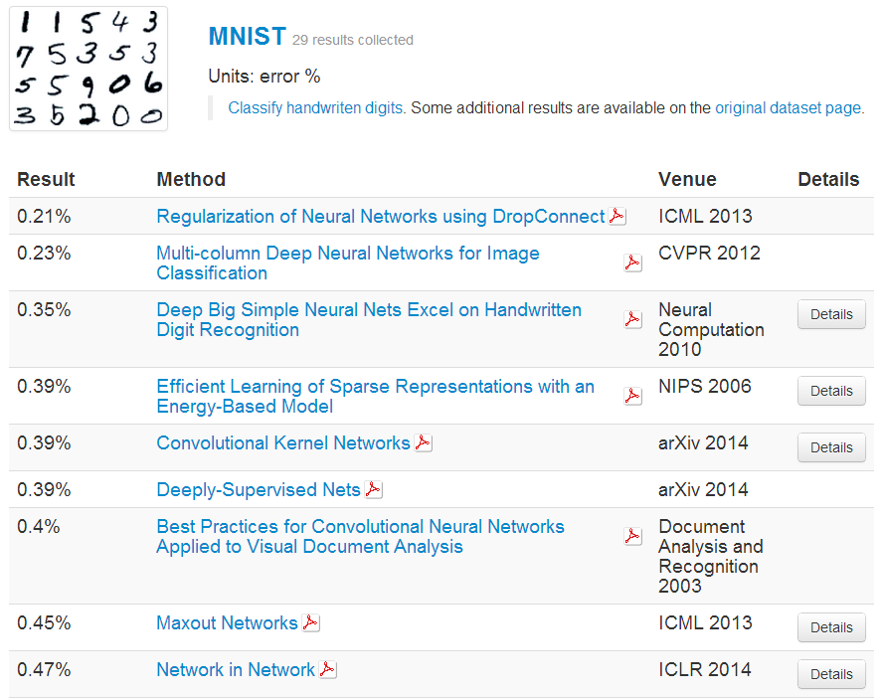
From http://rodrigob.github.io/are_we_there_yet/build/classification_datasets_results.html
Application – Image

Slide 12
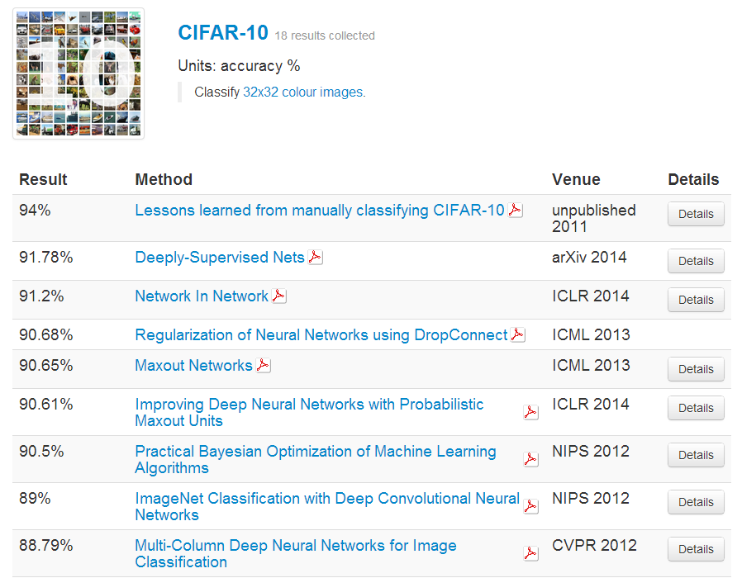
From http://rodrigob.github.io/are_we_there_yet/build/classification_datasets_results.html
Application – Image

Slide 13
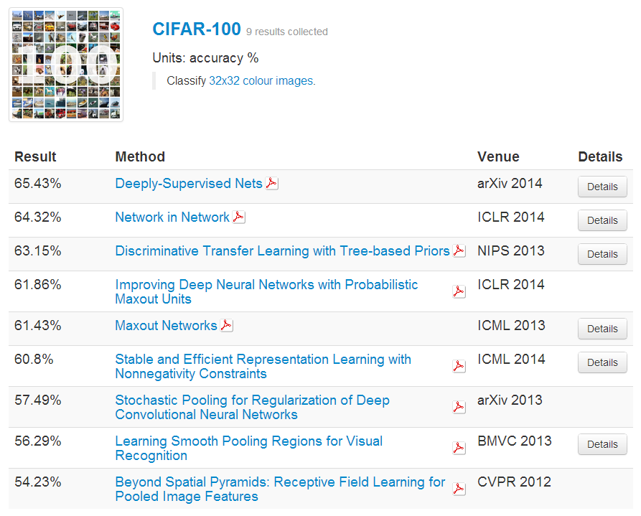
From http://rodrigob.github.io/are_we_there_yet/build/classification_datasets_results.html
Application – Image

Slide 14
Implementation – expand/unexpand
Forward
im2col
$${top}_{l}^{T}=W∙{top}_{l−1}^{T} , 其中{top}_{l−1}^{T}={bottom}_{l}^{T}$$

Slide 15


Implementation – expand/unexpand
Backprop
$$∆W_{l}=δ_{l}∙{top}_{l−1}^{T} , 其中{top}_{l−1}^{T}={bottom}_{l}^{T}$$
$$δ_{l−1}=W_{l}^{T}∙δ_{l}$$
col2im

Slide 16
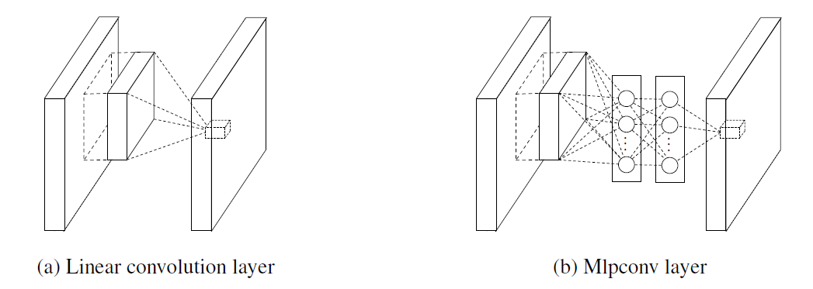
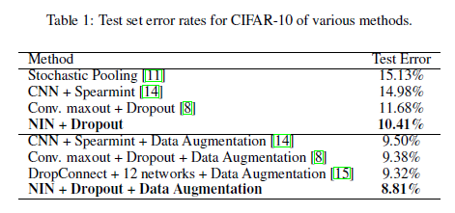
Extension – Network in Network
Lin, Min, Qiang Chen, and Shuicheng Yan. "Network In Network." arXiv preprint arXiv:1312.4400 (2013).

Slide 17
CONVOLUTION
num_output: 192
pad: 2
kernel_size: 5
RELU
CONVOLUTION
num_output: 160
pad: 1
kernel_size: 1
RELU
CONVOLUTION
num_output: 96
pad: 1
kernel_size: 1
RELU
POOLING
pool: MAX
kernel_size: 3
stride: 2
DROPOUT
dropout_ratio: 0.5
CONVOLUTION
num_output: 192
pad: 2
kernel_size: 5
RELU
CONVOLUTION
num_output: 192
pad: 1
kernel_size: 1
RELU
CONVOLUTION
num_output: 192
pad: 1
kernel_size: 1
RELU
POOLING
pool: AVE
kernel_size: 3
stride: 2
DROPOUT
dropout_ratio: 0.5
CONVOLUTION
num_output: 192
pad: 1
kernel_size: 3
RELU
CONVOLUTION
num_output: 192
pad: 1
kernel_size: 1
RELU
CONVOLUTION
num_output: 10
pad: 1
kernel_size: 1
RELU
POOLING
pool: AVE
kernel_size: 8
stride: 1
SOFTMAX_LOSS
Extension – Network in Network

Slide 18
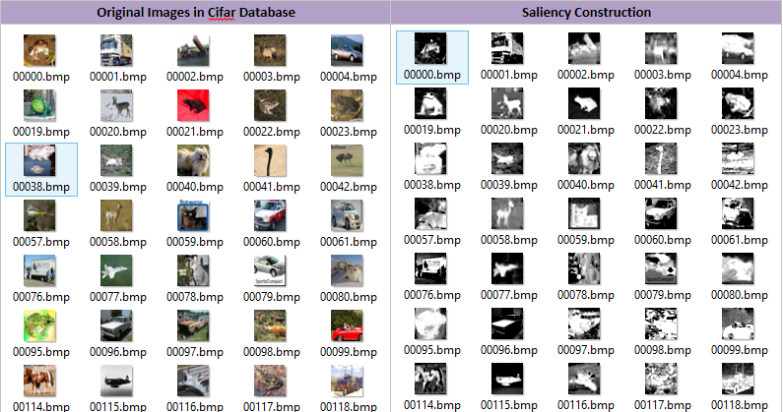
Extension – Parameterize CNN
Origin Image
Feature Map
Conv
Feature Map After Mask
Neural Net
multiply
Saliency
Mask
Sal_Calc

Slide 19
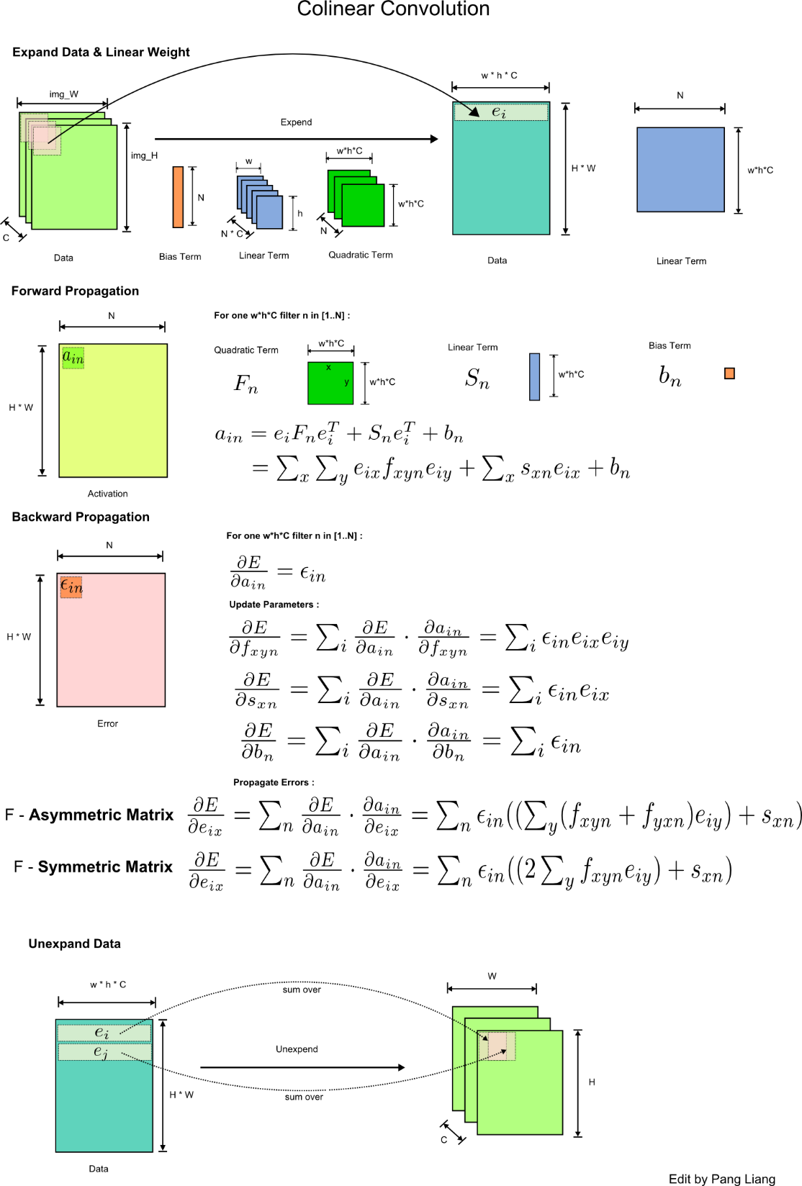
Extension – Colinear CNN

Slide 20
Q & A
Thanks!

Slide 21
Content
Derivation
Term expand
Digital image process
Edge detection
SIFT features
Important properties
Local invariance
Hierarchical structure
Definition
Convolutional Layer (with padding)
Pooling Layer
Active function - Relu
Application
Image
Voice
Text
Implementation
Expand / Unexpand method
Cuda-convnet
Extension
Network in Network
Saliency base improve
Colinear Convolutional Layer

